Slide 1
Seattle and King County EMS COVID-19 Response March 10, 2020
Michael Sayre, MD
Thomas Rea, MD

Slide 2
DAY 12
Seattle / King County EMS

Slide 3
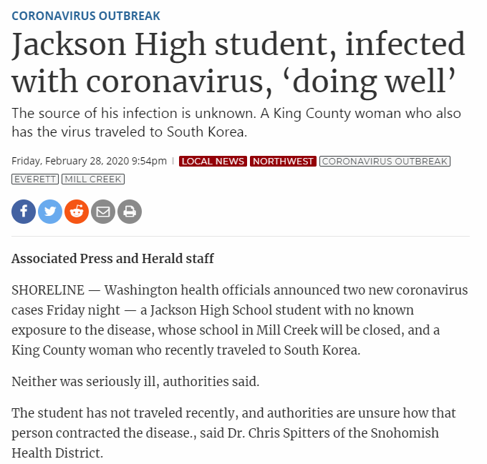
Notes:
On Friday, Feb 28th, the test was confirmed by the state health lab in Shoreline (just north of Seattle where Andy McCoy is the medical director). The news came out in the early evening on Friday. Around 9:30 PM, I received a call from the Seattle Fire Chief asking if I knew that a patient had died from COVID-19 at Evergreen hospital. This was news to me. I contacted Tom Rea who also knew nothing about the death.

Slide 4
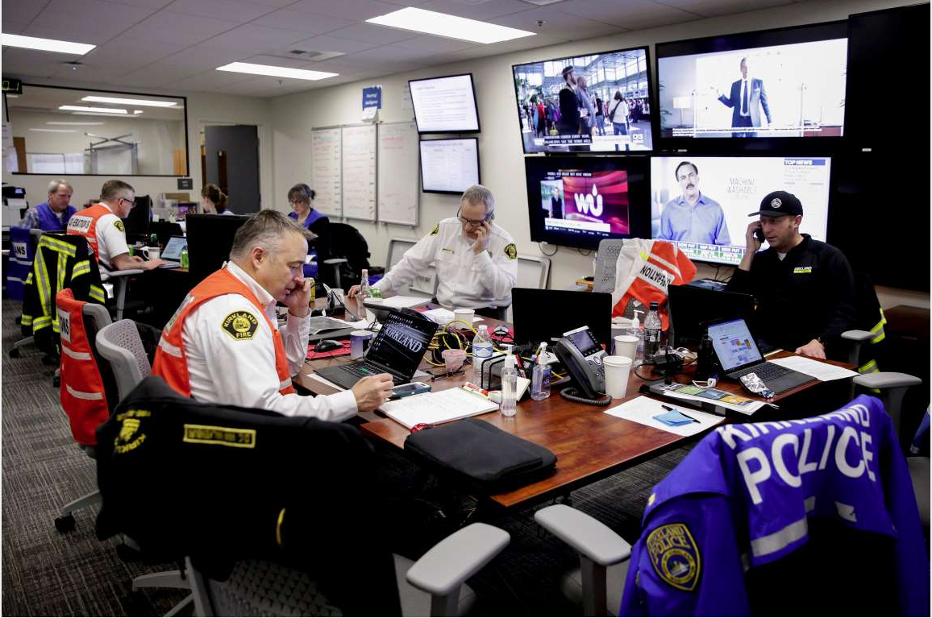
Dave Van Valkenburg
Deputy Chief
Kirkland Fire Department
Notes:
Emergency operations centers are open across the region.

Slide 5
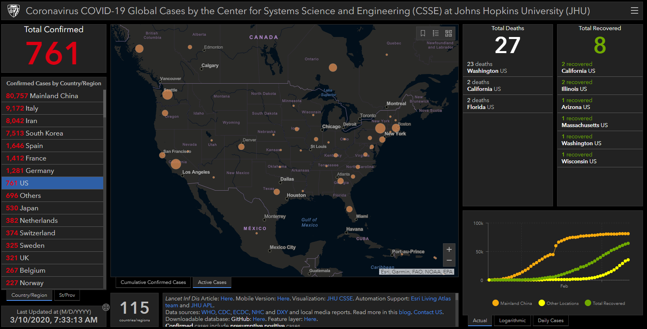
Notes:
All are aware that cases of COVID-19 disease are spreading across the USA.

Slide 6
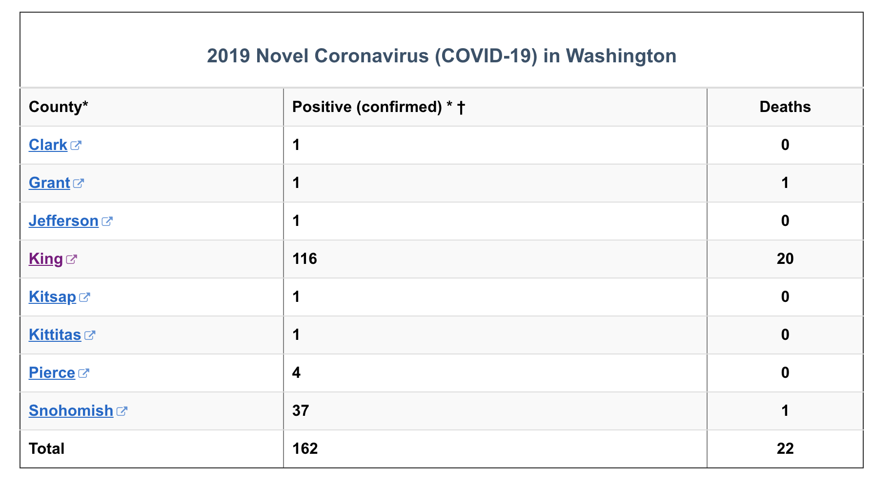
Notes:
As of 11:59 PM on March 8, there were 162 confirmed cases in King County with 20 deaths (17% mortality).

Slide 7
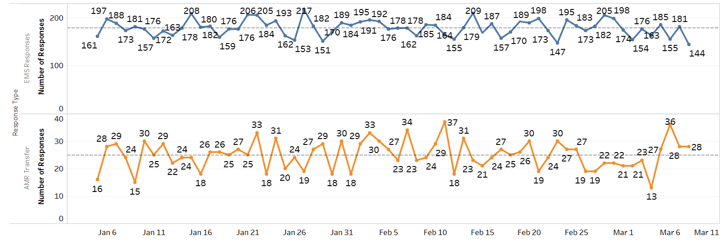
Seattle Fire Daily Medical Incidents

Slide 8
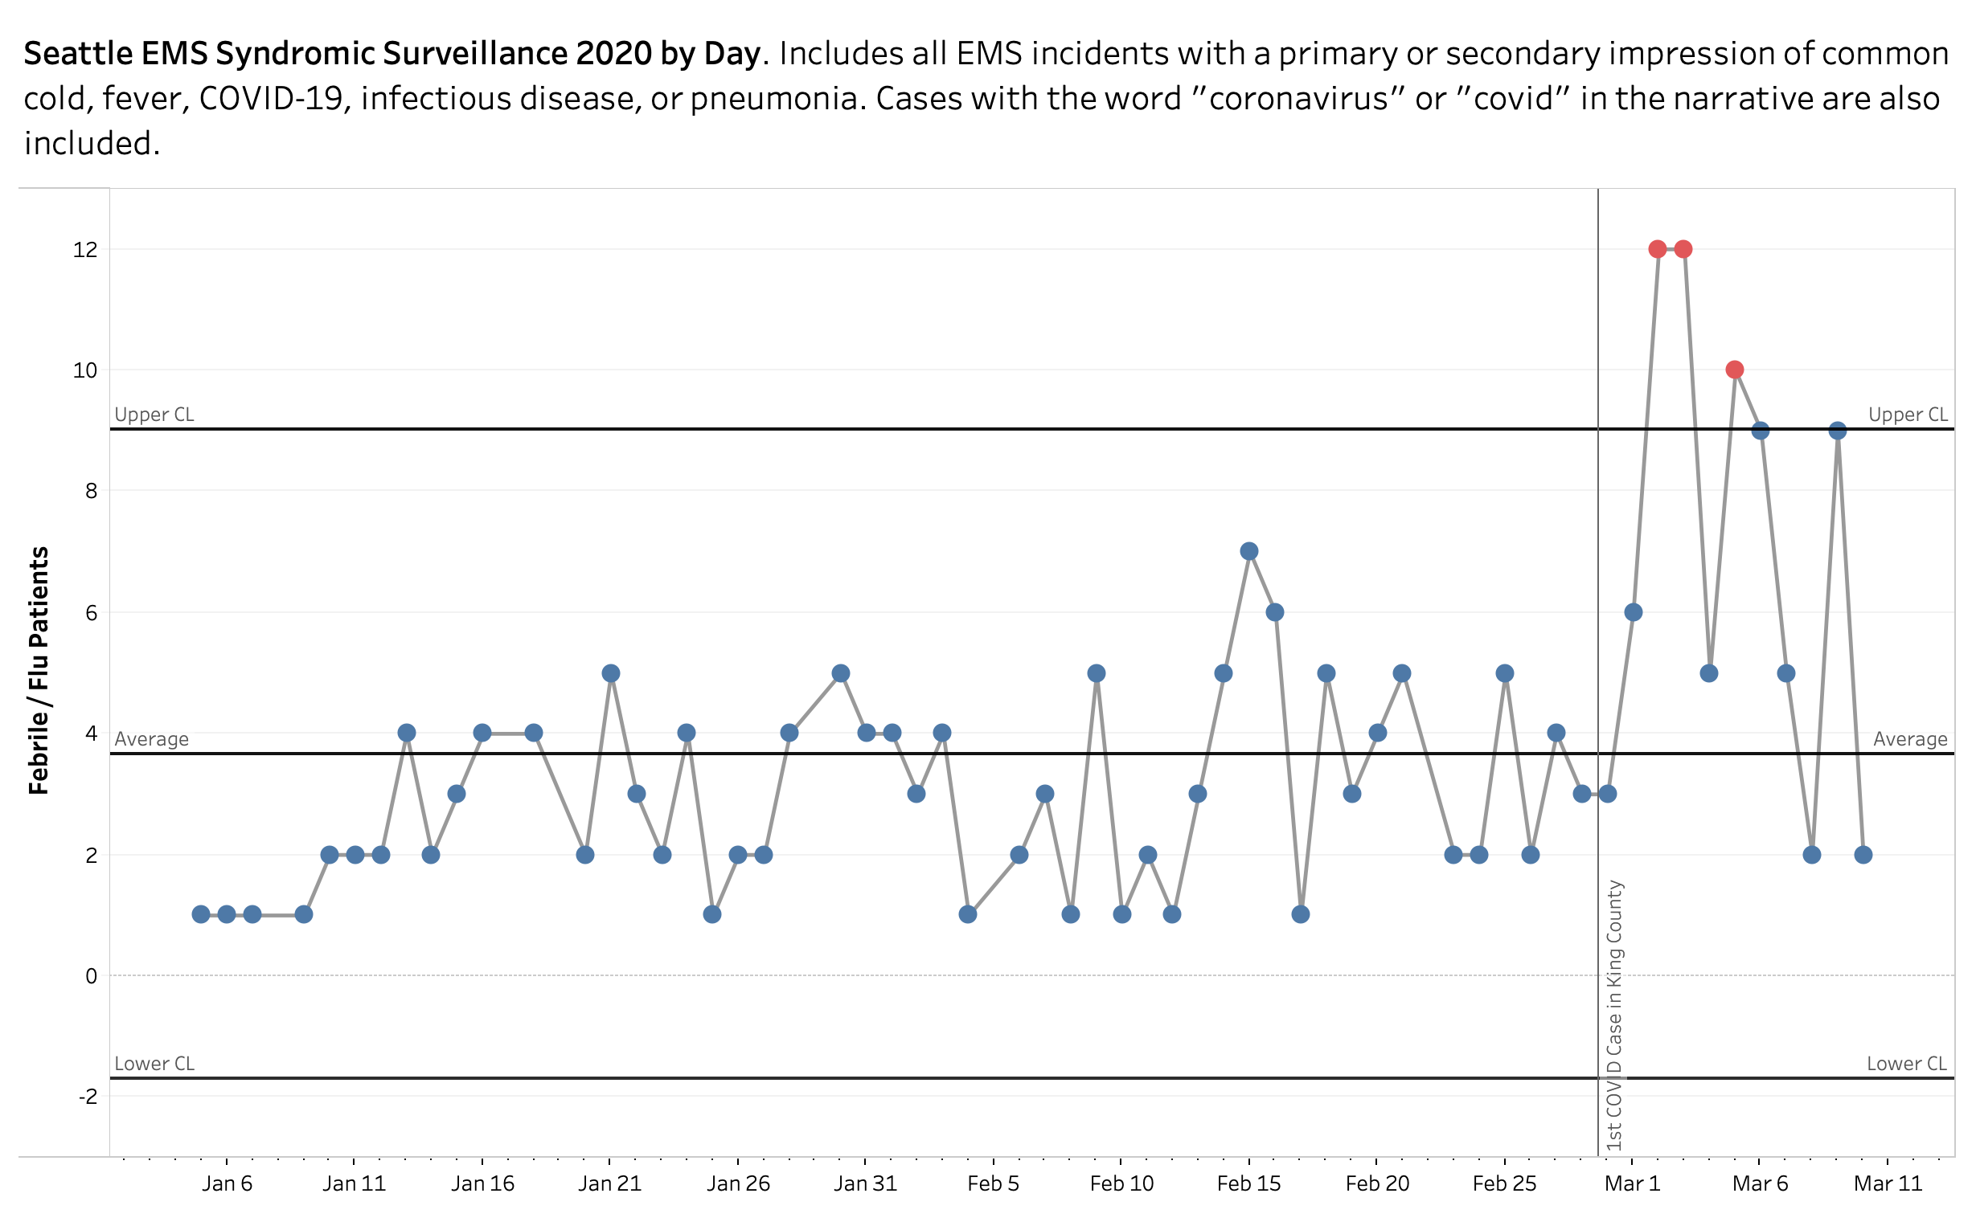

Slide 9
Lessons Learned

Slide 10
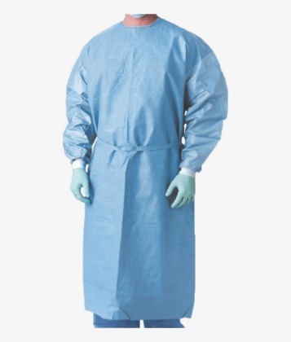
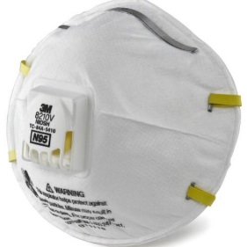
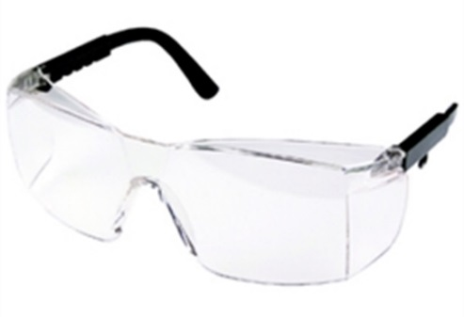
Current CDC PPE Recommendations
Mask N-95
Eye wear
Gown
Gloves
MEGG
Best Practices Donning & Doffing

Slide 11
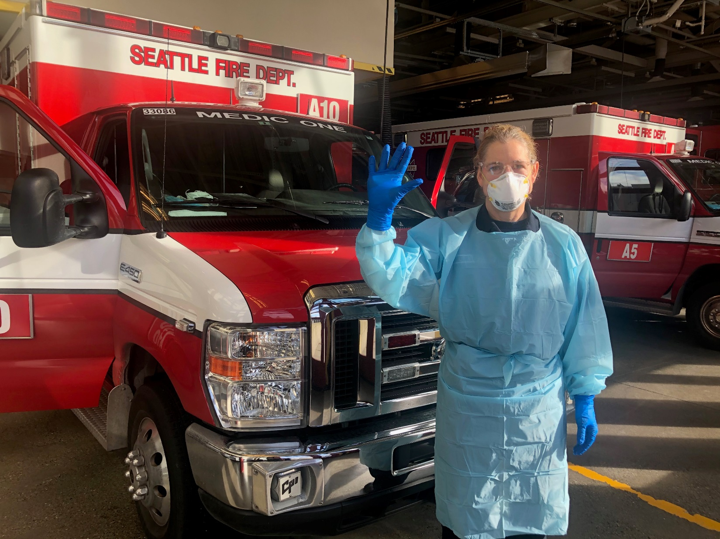
Notes:
Retrained ENTIRE workforce in PPE and updated n-95 fit testing

Slide 12
Decontamination

Slide 13
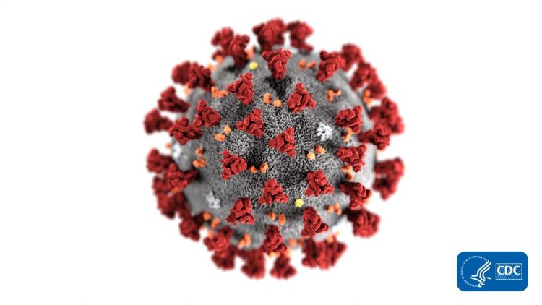
Exposures and Dose Relationship
Proximity to the patient
Duration with the patient
Type of care

Slide 14
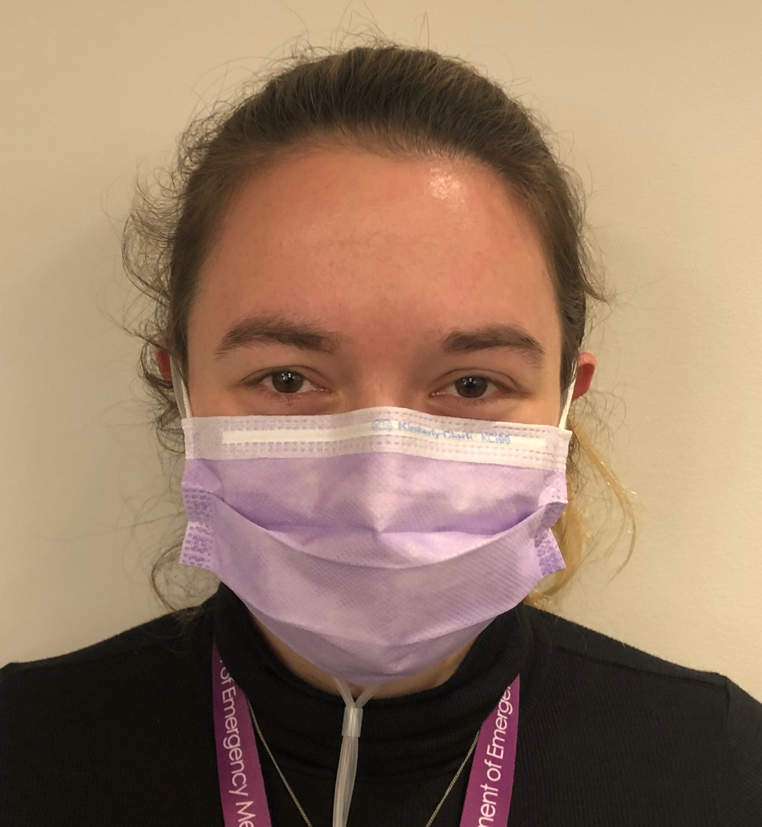
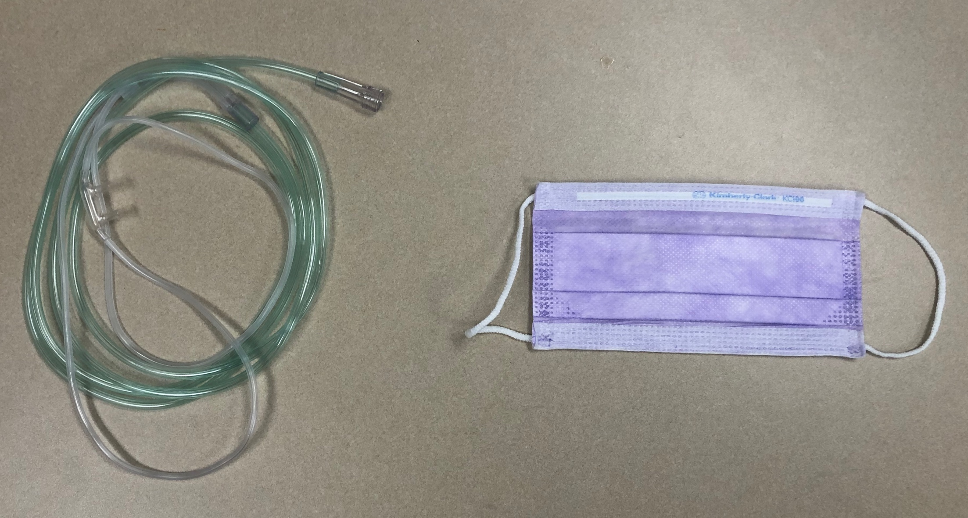
Nasal Cannula
Place Nasal Cannula
Place Surgical Mask over the face
Titrate oxygen flow rate from 2-6 LPM
+

Slide 15
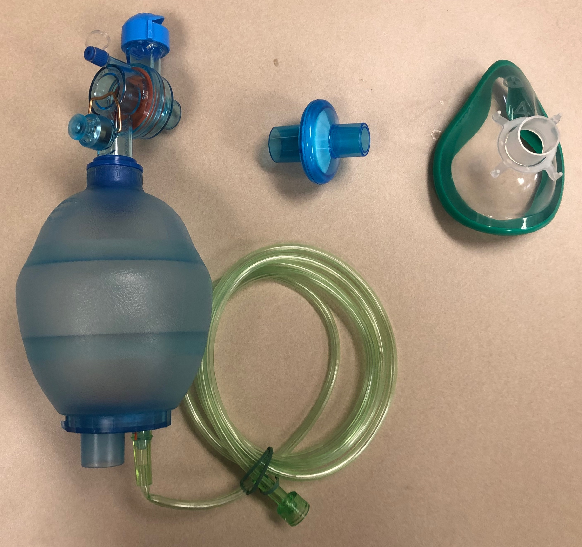
BVM
+
+
Place Filter between bag and mask
Ensure and maintain seal
Titrate oxygen flow rate to patient needs

Slide 16
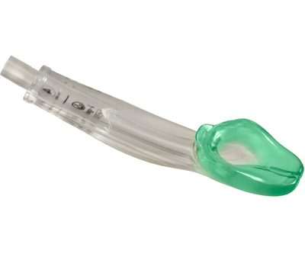
ALS Airway in a High-Suspicion COVID Patient

Slide 17
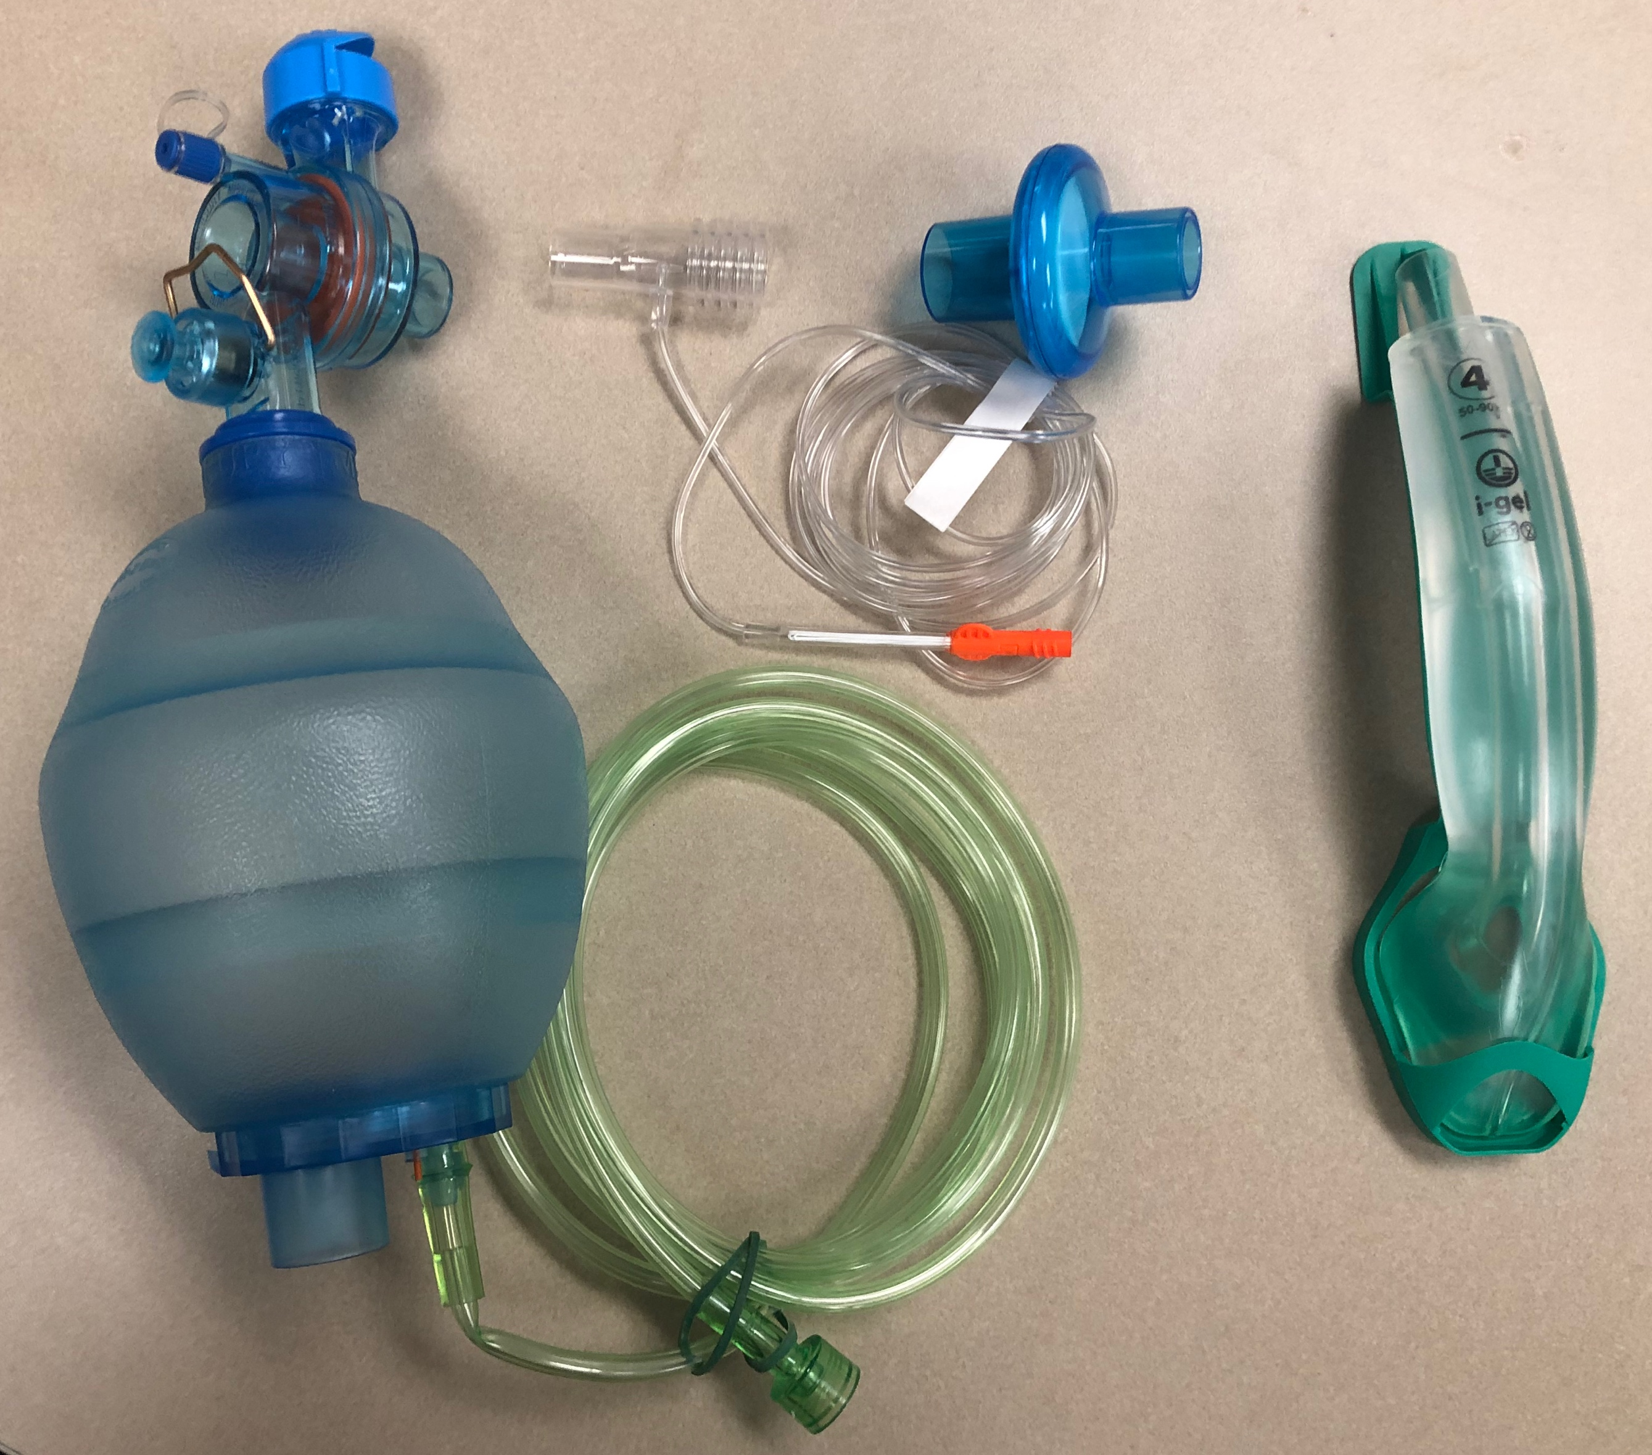
IGel
+
+
+
Place ETCO2 and then Filter onto bag
Ensure IGel is seated appropriately

Slide 18
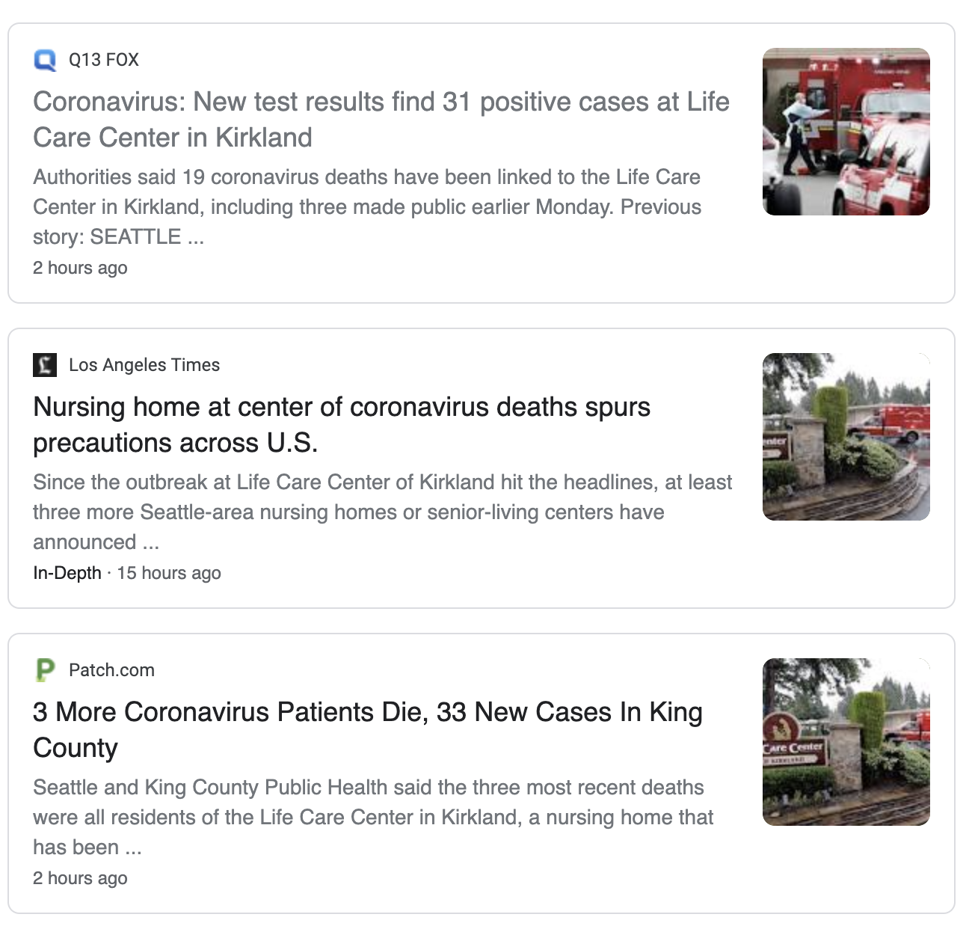
Notes:
Long term care facilities are high risk locations. Multiple locations in the county now reporting cases in residents.

Slide 19
Dispatch Criteria
Respiratory Only -> “PPE ADVISED”
Respiratory + Travel or Exposure -> “PPE ADVISED”
Fever Only -> “PPE ADVISED”
Fever + Travel or Exposure -> “PPE ADVISED”
Fever + Respiratory Only -> “PPE ADVISED”
Fever + Respiratory + Travel or Exposure -> “PPE ADVISED – HIGH RISK”
Respiratory Only -> “PPE ADVISED”
Fever Only -> “PPE ADVISED”
Fever + Respiratory -> “PPE ADVISED”
Higher Risk Location -> “PPE ADVISED”
Together about 15% of responses

Slide 20
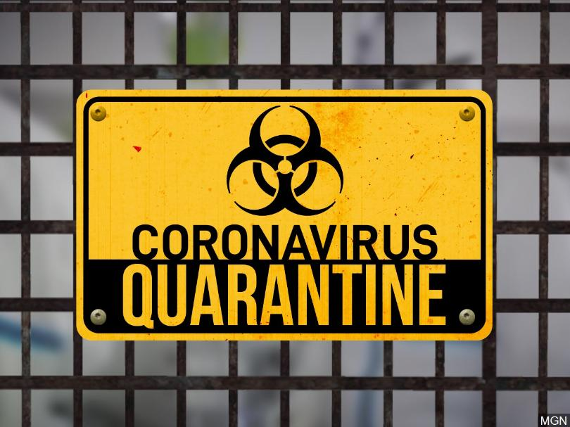
Should an exposure occur – Quarantine vs Isolation

Slide 21
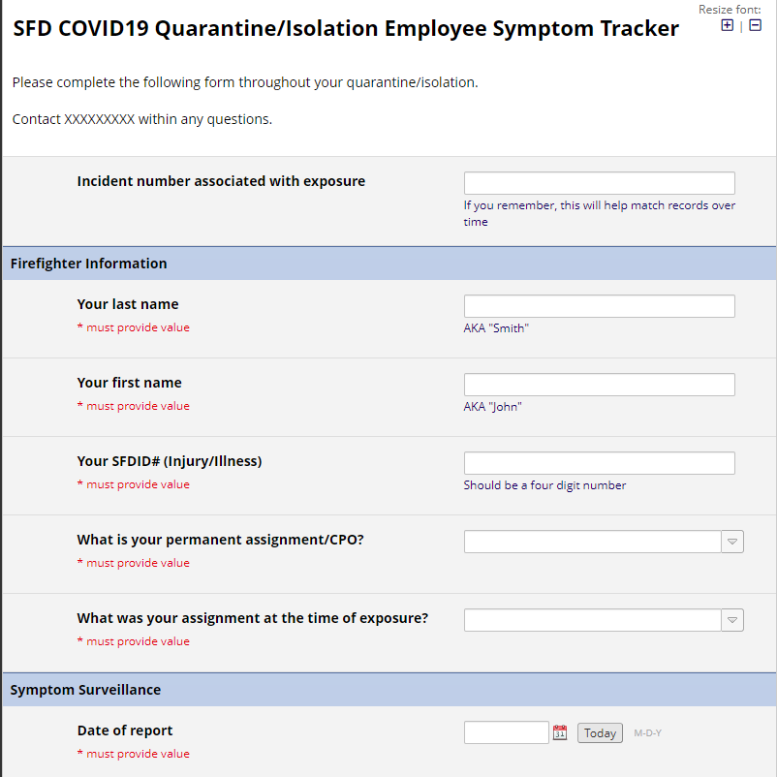
Quarantine is the term if an exposed person is asymptomatic.
Current CDC understanding is asymptomatic = not contagious
Avoid public. Avoid contact with family.
Daily monitoring of temp and symptoms for 14 days.
DRAFT REDCap Form

Slide 22
Should an exposure occur – Quarantine vs Isolation
Isolation is the term if an exposed person becomes symptomatic.
Requires COVID-19 testing (nasopharyngeal swab)*
Current CDC understanding is symptomatic = contagious
Avoid public. Isolate from family.
Return to contact and work based on individual assessment.

Slide 23
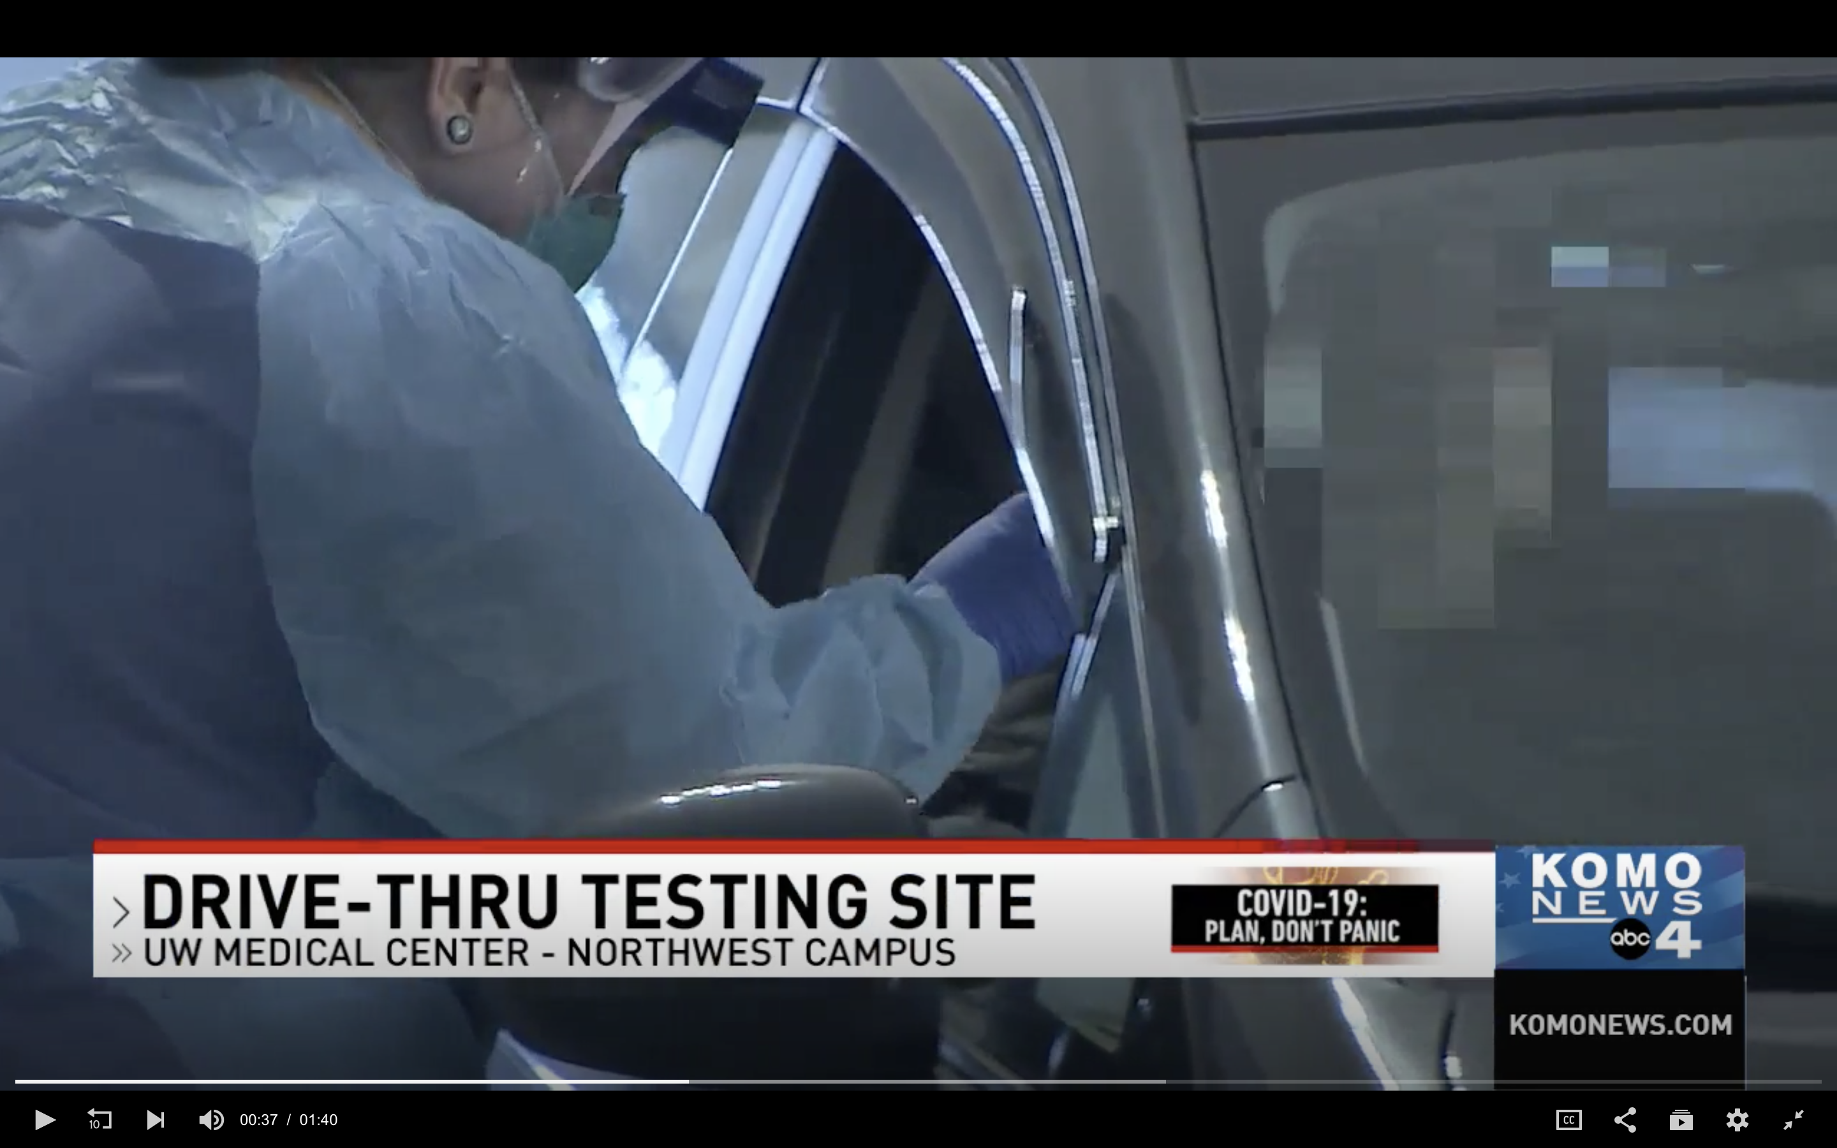

Slide 24
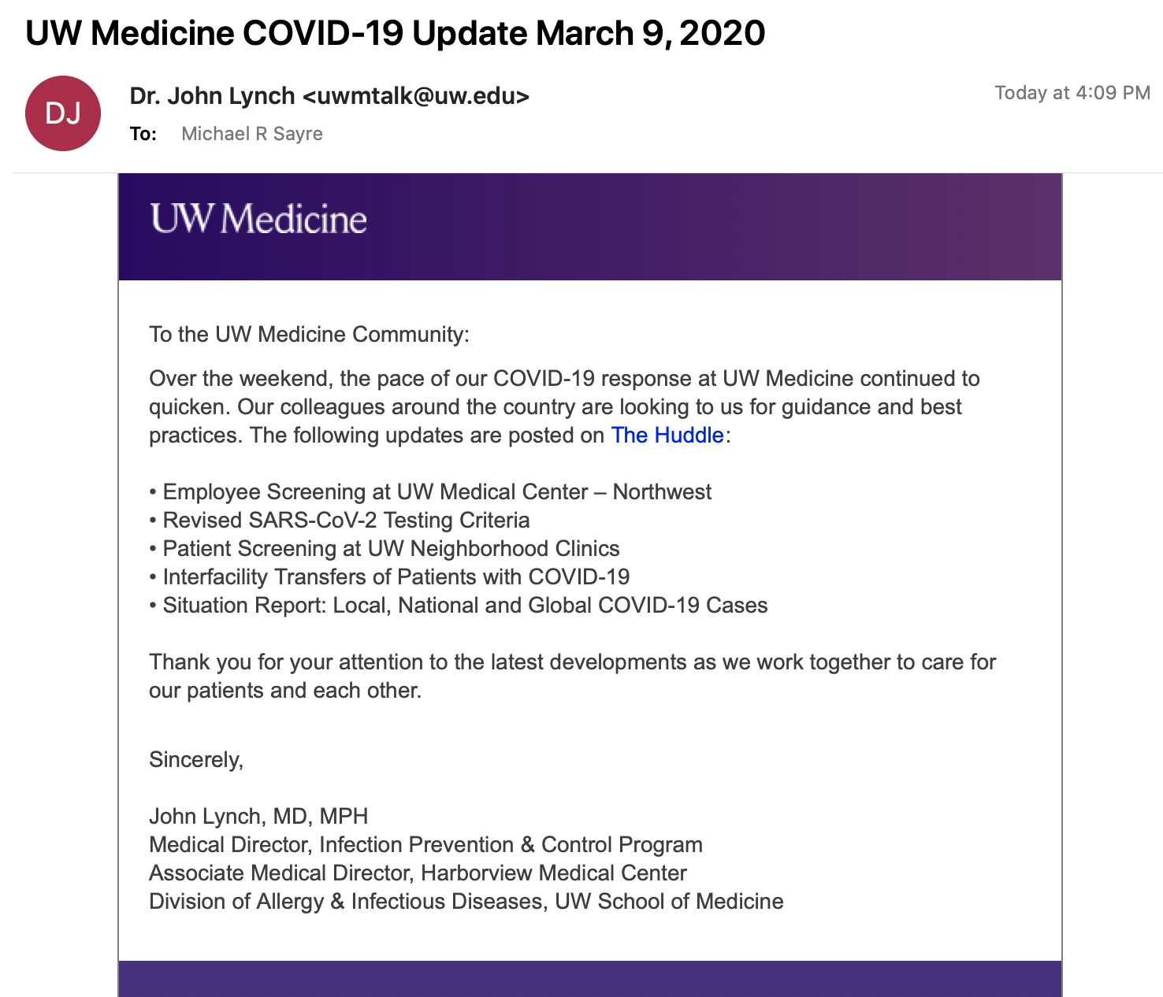
One message a day
No attachments
Hyperlink for more information
Only access to most updated policies

Slide 26
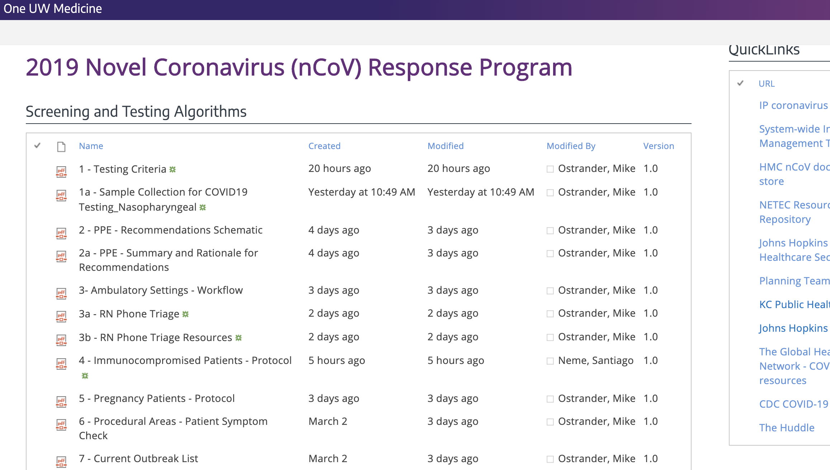

Slide 27
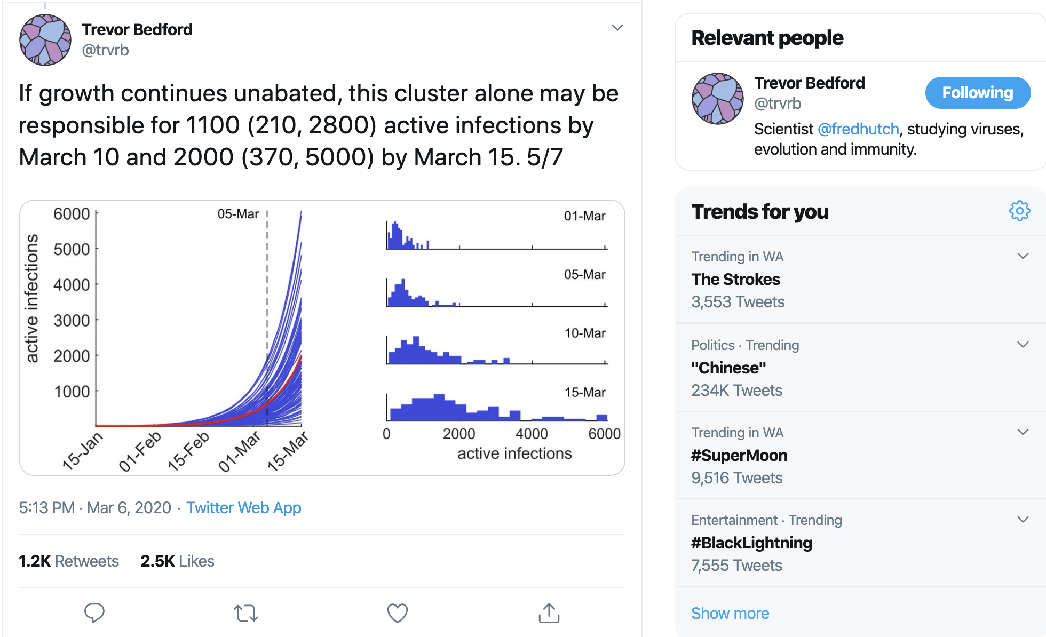
Notes:
This is going to be here for 12-18 months.

Slide 28
A Perspective: The Challenge of COVID-19
COVID-19 is with us for while – community transmission is “imminent”
Health hygiene is essential (hand washing, home when ill, social distancing)
Containment versus mitigation – multiple strategies for management
Team work will raise all boats
Even more resilience will be required
Common sense and good judgement will be paramount

Slide 29
Questions
http://bit.ly/EMSCOVID19

Slide 30
Follow @ResuscAcademy on Twitter
Read www.resuscitationacademy.org/blog
Notes:
Thank you for your willingness to be here today. We in the Seattle Medic One program look forward to working with YOU to save lives from cardiac arrest. Thank you.

